Slide 1
Library Resources on
Ancient Greece
Leo MA
Head
New Asia College Ch’ien Mu Library and
United College Wu Chung Multimedia Library
2 March 2016

Slide 2
Content
General Library Services
Print Collection on Ancient Greece
Electronic Resources on Ancient Greece

Slide 3
General Library Services

Slide 4
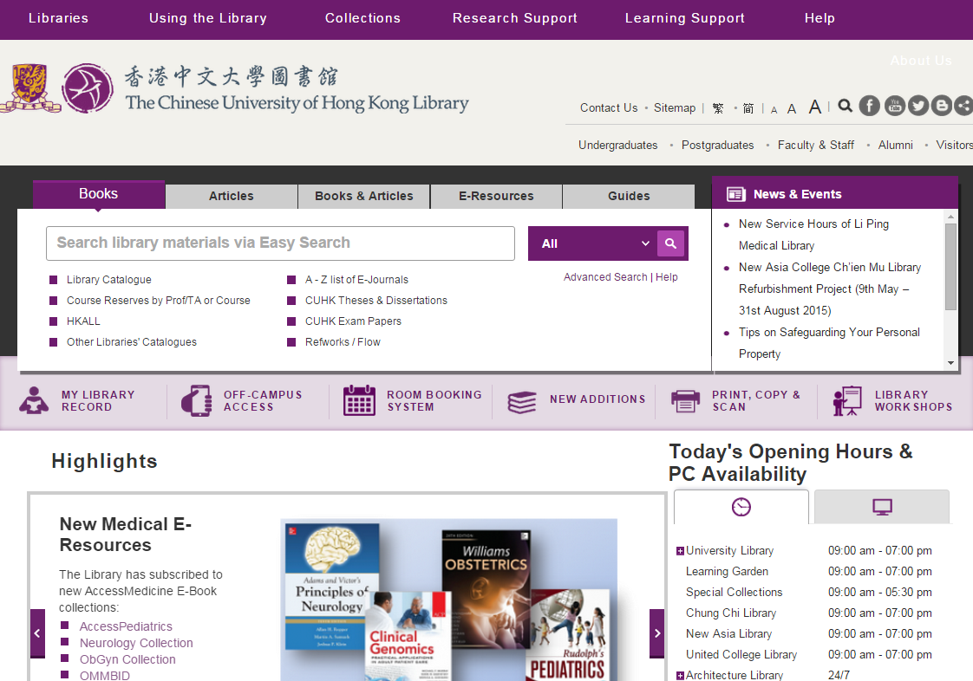
Library Catalogue
Entry Point of “Easy Search”
Entry Point of “Full Catalogue Search”

Slide 5
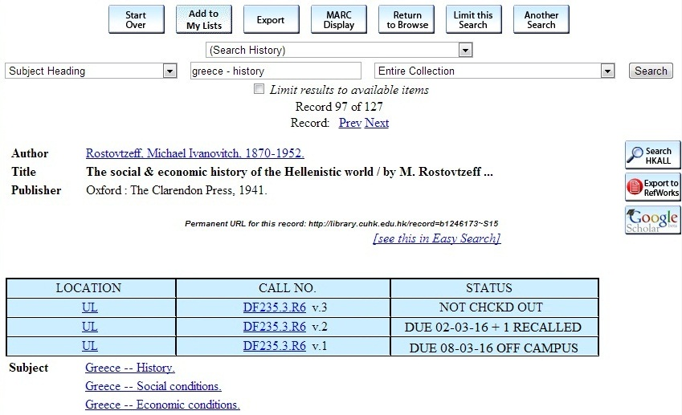
Library Catalogue
Location and Call no. show where the item is
Make sure the STATUS is NOT CHCKD OUT

Slide 6
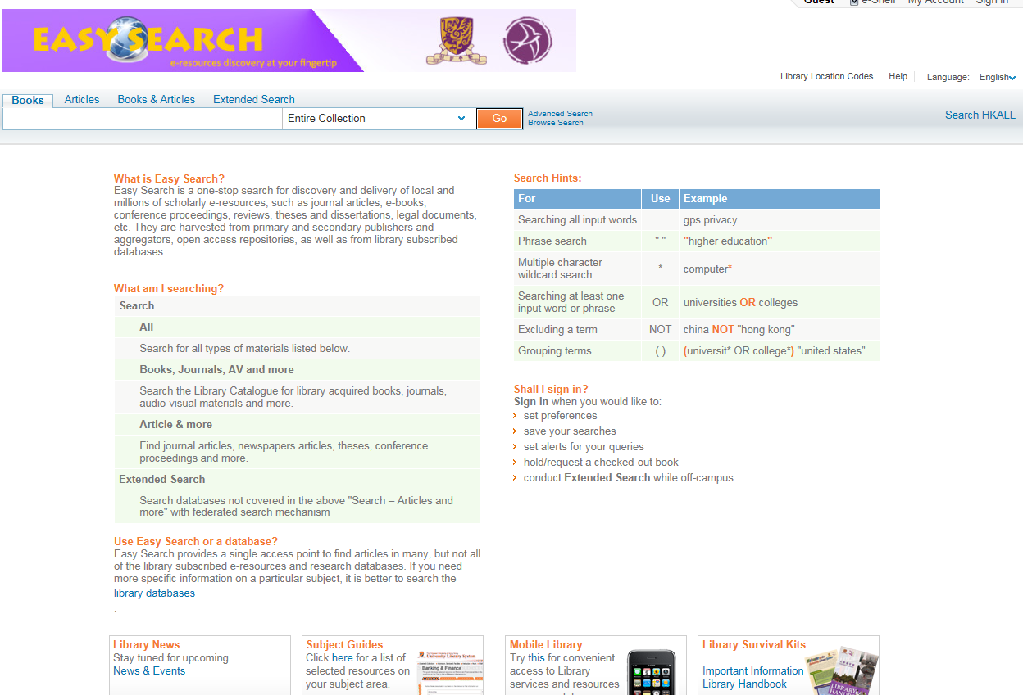
Easy Search

Slide 7
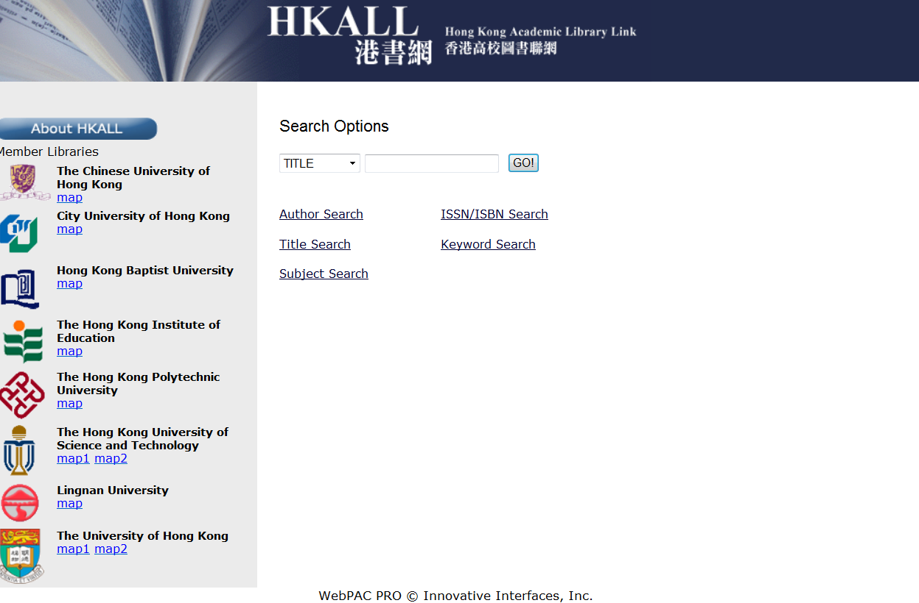
HKALL
Eligible users can request books (excluding serials, media and other non-print materials) with the status "AVAILABLE" in other HKALL libraries UNLESS the required books are already available in our collection.
Details please refer the link: http://www.lib.cuhk.edu.hk/en/use/interlibrary-loan/hkall

Slide 8
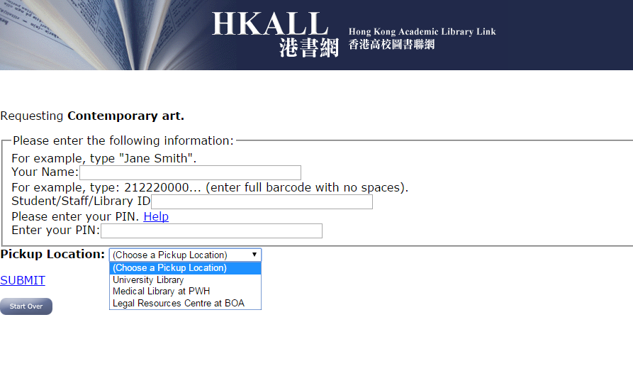
HKALL

Slide 9
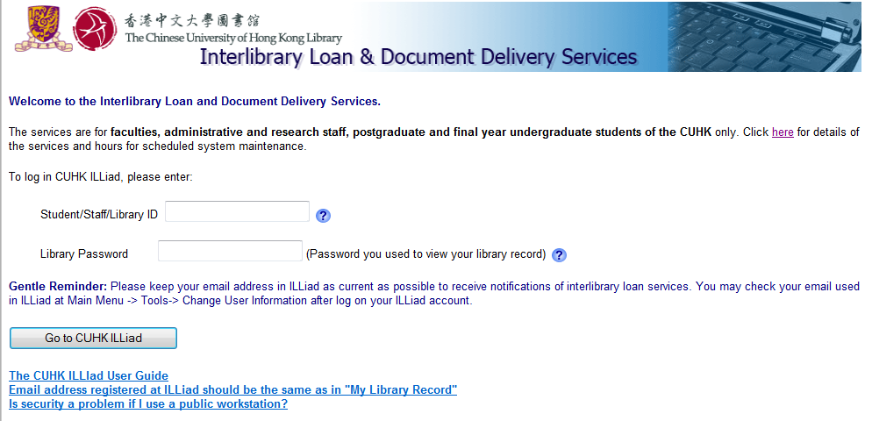
Library Services
InterLibrary Loan and Document Delivery
  User guide: http://www.lib.cuhk.edu.hk/sites/cuhk/files/page/using_the_library/interlibrary/illiad_guide_en.pdf
  100 Free Quota to obtaining free of charge articles from CUHK libraries, local libraries as well as overseas libraries with reciprocal agreements.
  More information: http://www.lib.cuhk.edu.hk/en/use/interlibrary-loan/document-delivery
Access to Other UGC-funded Libraries

Slide 10
Print Collection on Ancient Greece

Slide 11
University Library & Branch Libraries
Libraries | Location Code | Subject
大學圖書館 University Library | UL | Business, History, Western Literature, Political Science, Science and Engineering, Social Sciences and Military Science
崇基學院牟路思怡圖書館 Chung Chi College Elisabeth Luce Moore Library | CCL | Education, Music and Religious Studies
新亞書院錢穆圖書館 New Asia College Ch’ien Mu Library | NAL | Chinese Language & Literature and Fine Arts
聯合書院胡忠多媒體圖書館 United College Wu Chung Multimedia Library | UCL | Multimedia Library and Philosophy
建築學圖書館 Architecture Library | ARL | Buildings Industry and Environmental Science
利國偉法律圖書館 Lee Quo Wei Law Library | LC | Law collection
李炳醫學圖書館 Li Ping Medical Library | MD | Clinical and Medical Materials

Slide 12
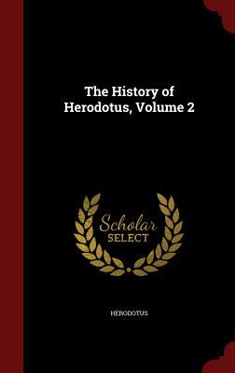


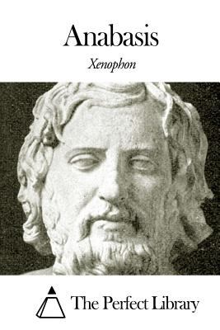
Ancient Greece Collection
Holdings of ancient Greece collection as of February 24, 2016:
Eastern Language | Western Language | Total
183 volumes | 2,377 volumes | 2,560 volumes
Notes:
Searching strategy
subject:(gree*) and subject:(histor*) and not subject:(green)

Slide 13
Ancient Greece Collection
Total: 2,560 volumes

Slide 14
Ancient Greece Collection
Call no. | Subject | Location
B1-5802 B108-708 | Philosophy (General) Ancient | UCL and UL
BL1-2790 BL689-980 BL700-820 | Religions. Mythology. Rationalism European. Occidental Classical (Etruscan, Greek, Roman) | UCL and UL
BX400-756 BX610-620 | Divisions of the church Church of Greece | CCL
DF10-951 DF10-289 DF501-649 | History of Greece Ancient Greece Medieval Greece | UL
GV1-1860 GV557 1198.995 | Recreation. Leisure Sports | UL
HC10-1085 HQ1-2044 | Economic history and conditions The Family. Marriage. Women | UL
JC11-605 | Political theory. The state. Theories of the state | UL
PA201‑899 PA1000‑1179 PA3050‑4505 | Greek philology and language Medieval and modern Greek language Greek literature | UL
U1 900 U27-43 | Military science (General) History of military science | UL

Slide 15
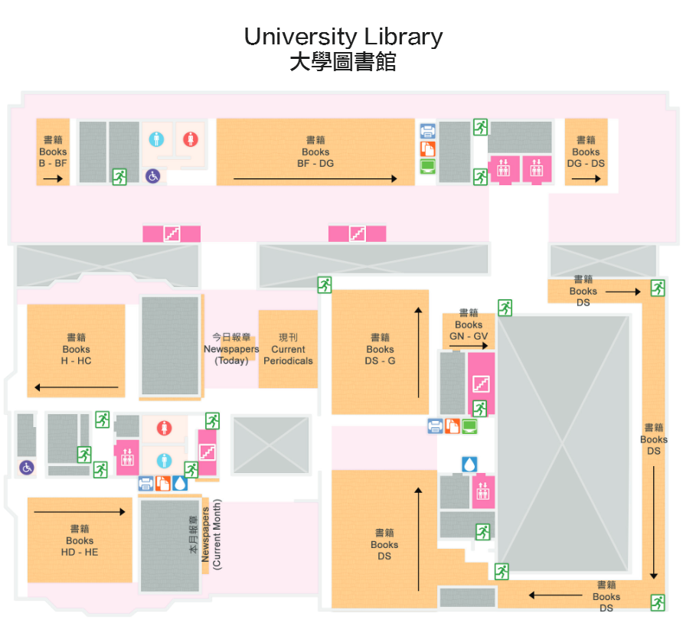
Location of History of Greece Collection in UL
On the 2/F
Location: UL
History collection:
For details, please refer to: http://www.lib.cuhk.edu.hk/floorplan/staticmap.php?lang=en&lib=ul

Slide 16
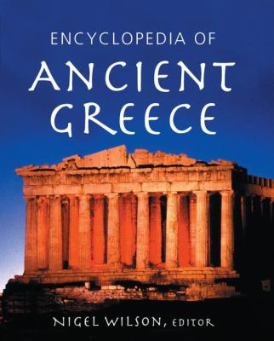


Reference Tools
Dictionaries and Encyclopedias
字典/百科全書
Biographies and Bibliographies
人物傳記 /目錄
Atlas 地圖

Slide 17
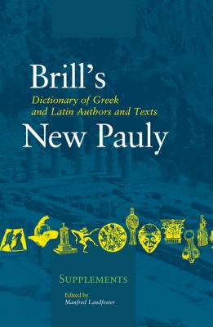
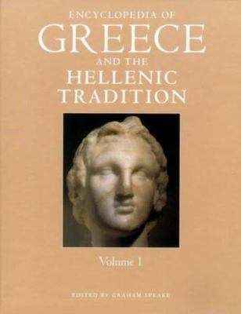
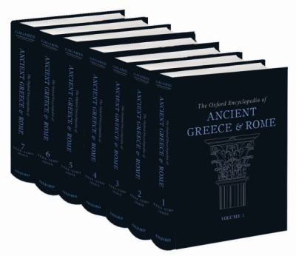
Dictionaries & Encyclopedias
Dictionary of Greek and Latin authors and texts
(ulr: PA31 .G4713 2009)
Encyclopedia of ancient Greece
(ulr: DF16 .E52 2006)
Encyclopedia of Greece and the Hellenic tradition
(ulr: DF757 .E53 2000)
The Oxford encyclopedia of ancient Greece and Rome
(ulr: DE5 .O95 2010)

Slide 18
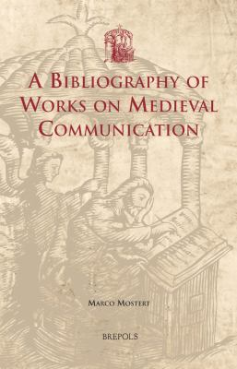
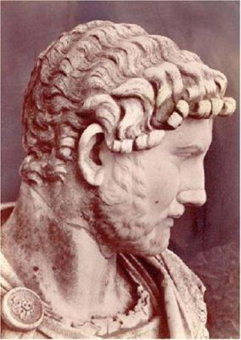
Biographies and Bibliographies
A bibliography of works on Medieval communication
(ulr: Z5630 .M57 2012)
A dictionary of Greek and Roman biography and mythology
(ulr: DE5 .D52 2007)
Who's who in the Greek world
(ulr: DE7 .H39 2002)

Slide 19
Atlas
Atlas of the Greek and Roman world in antiquity
(ula: G1033.A84)
Barrington atlas of the Greek and Roman world
(ulrf G1033 .B3 2000)

Slide 20
Electronic Resources on Ancient Greece

Slide 21
Electronic Resources
Databases (768)
  Article Databases
    e.g. Academic Search Premier
  Encyclopedias & Dictionaries
    e.g. Oxford Reference Online Premium
  Image & Sound Databases
E-Journals (133,611)
  Browse by subject “History”
E-Books (4,019,735)
E-News
CUHK Library Digital Initiative (DAO)
Warning: Excessive downloading is prohibited. Click here to read the Library Regulation on Systematic or Excessive Downloading.

Slide 22
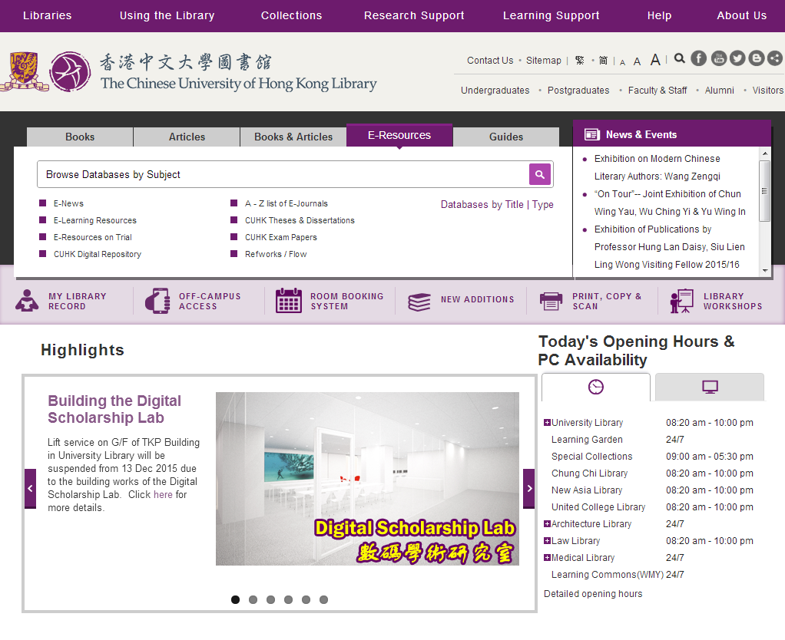
LibGuide
List by Title/ Type
Entry point of
CUHK Digital Repository

Slide 23
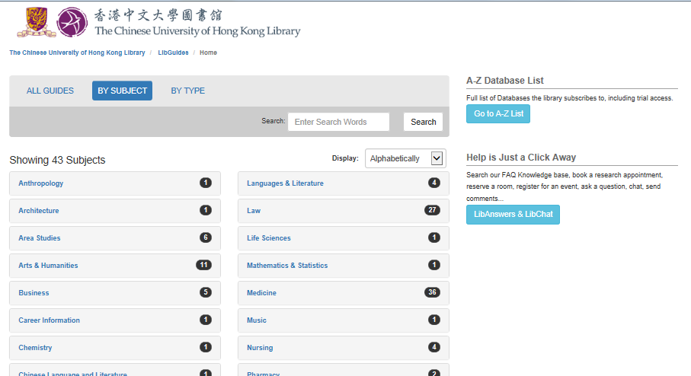
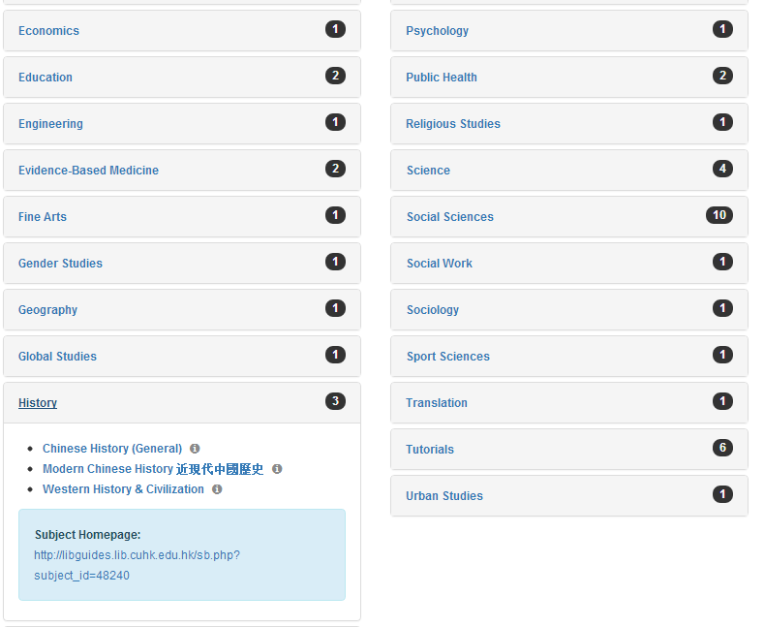
LibGuides

Slide 24
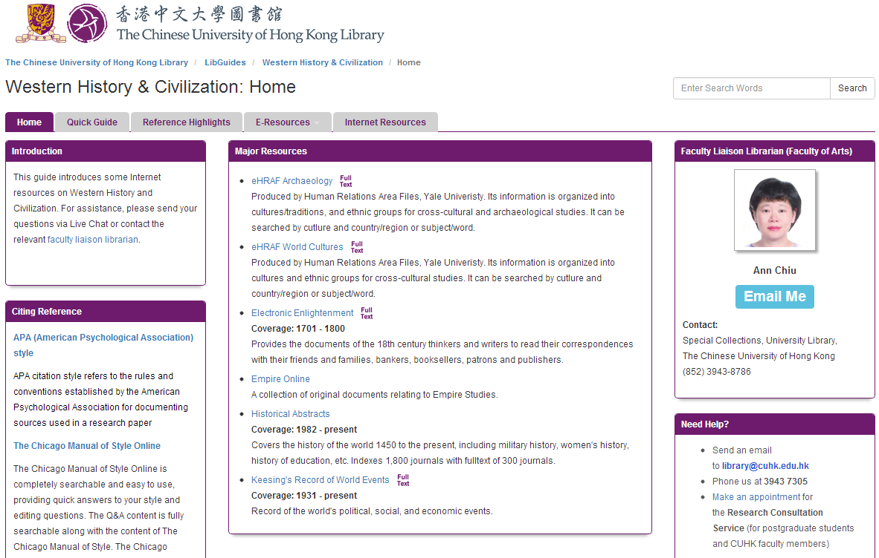
LibGuides

Slide 25
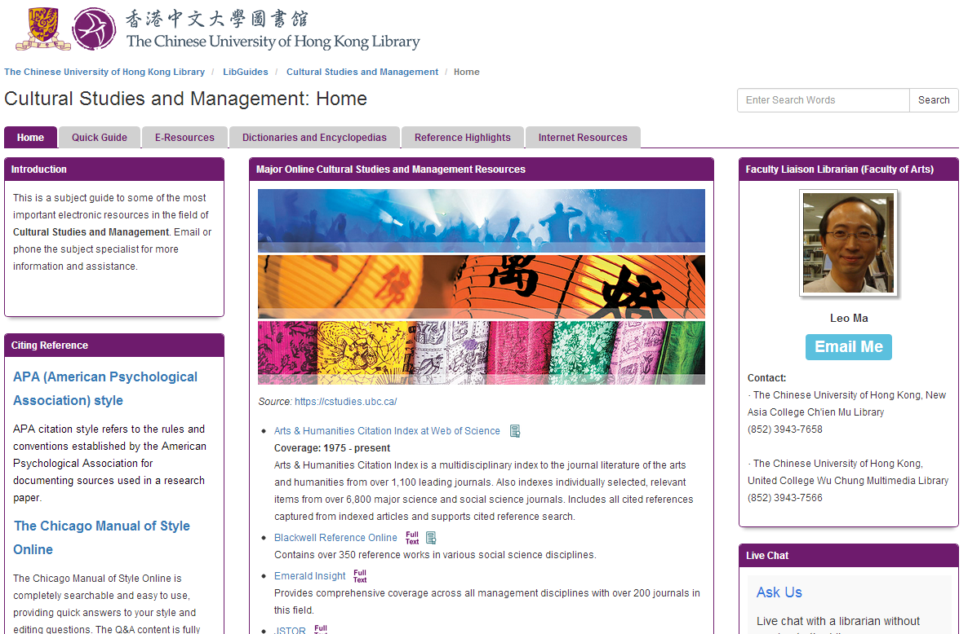
LibGuides

Slide 26
Databases
Article Databases
Find journal articles, newspaper articles, theses etc.
Full text may/may not be available
Print journals may/may not be available in the libraries
Search results provide citation information:
  Author
  Article title
  Journal or magazine title
  Publication date
  Volume/issue numbers
  Pages

Slide 27
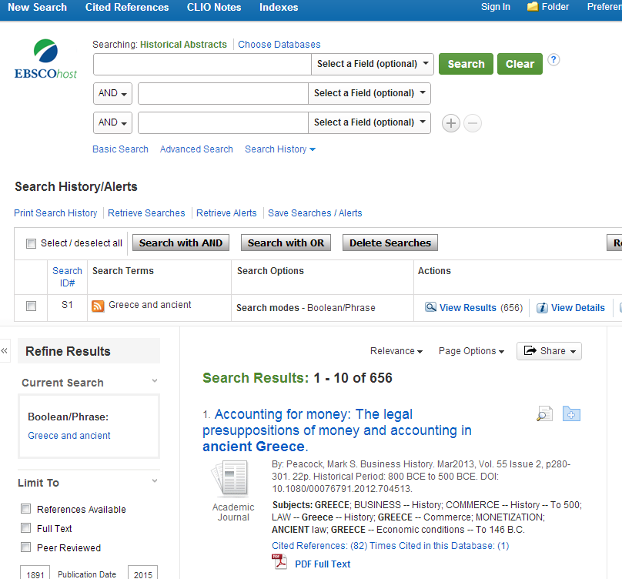
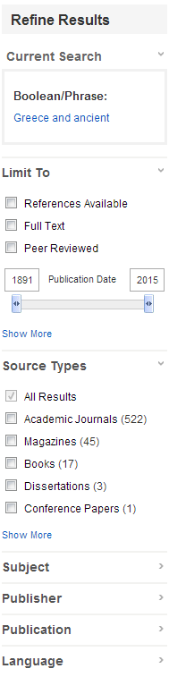
Brief Display

Slide 28
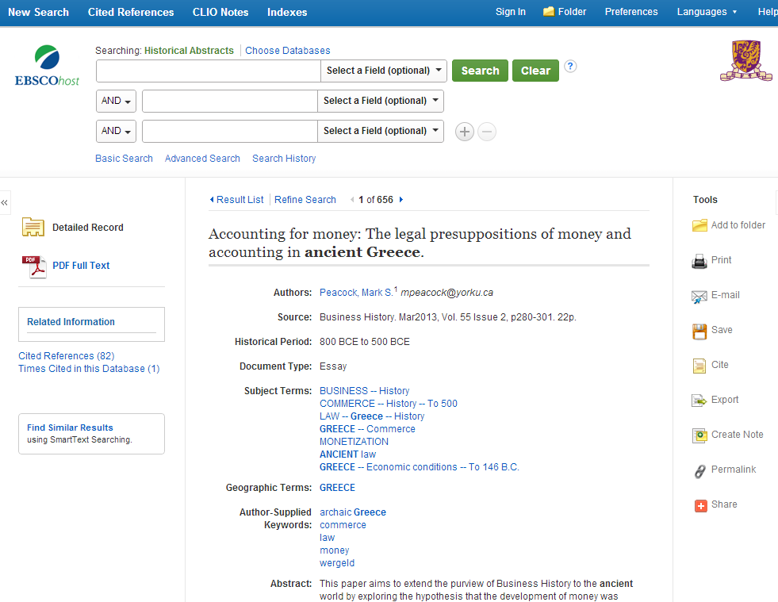
Full Display

Slide 29
Multi-Discipline Databases
Database | Coverage | Full-text
Academic Search Premier 1975 - present | A multi-disciplinary database provides full text for more than 4,500 journals. | ✓
Arts & Humanities Citation Index at Web of Science 1975 - present | Arts & Humanities Citation Index is a multidisciplinary index to the journal literature of the arts and humanities from over 1,100 leading journals. Also indexes individually selected, relevant items from over 6,800 major science and social science journals. Includes all cited references captured from indexed articles and supports cited reference search. | ✗
JSTOR | Includes archives of several hundred well-known academic journals across the humanities, social sciences and sciences, dating back to their first issues. The most recently published issues (past 3-5 years) are not available. | ✓
Project MUSE | Provides access to 400 humanities and social sciences journals. | ✓

Slide 30
Multi-Discipline Databases
Database | Coverage | Full-text
Airiti Library 華藝線上圖書館 | 涵蓋逾七百種在台灣出版的關於人文學、自然科學、醫學與生命科學、應用科學及社會科學的期刊。 | ✓
China Journal Net (CJN) 中國期刊全文數據庫 1915 - present | Provides over 8,700 journals published in China, subjects including natural science, engineering, agriculture, philosophy, medicine, humanities and social sciences. | ✓
HyRead台灣全文資料庫 1974 - present | Covers over 400 periodicals on humanities, social science, science, applied science, and bio-medicine published in Taiwan. | ✓
History Databases
Database | Coverage | Full-text
Historical Abstracts 1982 - present | Covers the history of the world 1450 to the present, including military history, women's history, history of education, etc. Indexes 1,800 journals with fulltext of 300 journals. | ✗

Slide 31
Internet Resources
Ancient-Greece.org
A collection of resources about the history, timeline, maps, architecture, art, museums, archaeology and photographs of ancient Greece.
Exploring Ancient World Cultures
An online course of the ancient and medieval worlds includes the histories and cultures of the Near East, India, Egypt, China, Greece, Rome, Early Islam and medieval Europe.
Internet Ancient History Sourcebook
The sourcebook is organized into three sections: (1) The Ancient Near East: Mesopotamia, Egypt, Persia, Israel; (2) Greek Civilizations: Greece, Hellenistic World; and (3) Rome: Rome, Late Antiquity, Christian Origins.

Slide 32
Where to Start Searching?
Use the RIGHT information tools to start your search
Tools | Coverage | When to use it
Library catalogue | Holdings collected by library e.g. books, periodicals, reports, conference proceedings, theses, government documents, etc. | Find background or historical information Overview on a topic or subject
Indexes and research databases | Index published works such as magazine and journal articles, conference papers etc. | Scholarly research on a specific subject or topic, recent research
Internet search tools (e.g. search engine) | Free information on the Web | Most updated information and current events

Slide 33
Example on how to locate information of
‘Women in Archaic Greece (800–480 BC)’

Slide 34
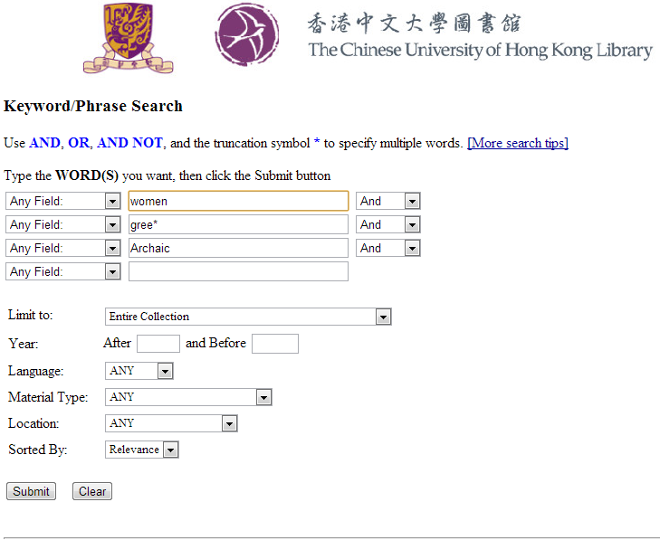
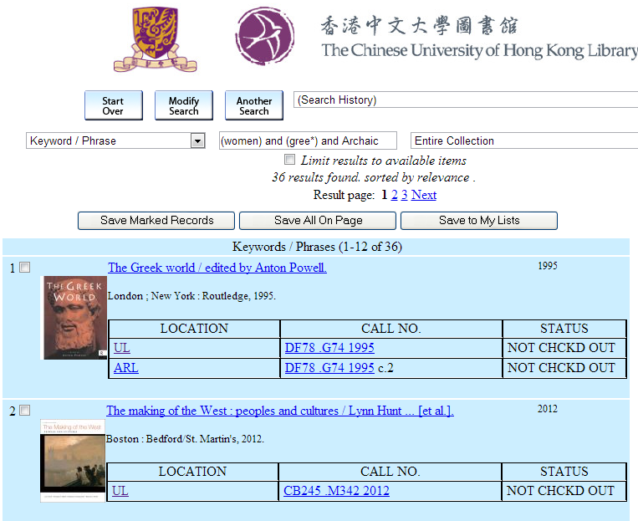
Example: Women in Archaic Greece
36 results found

Slide 35
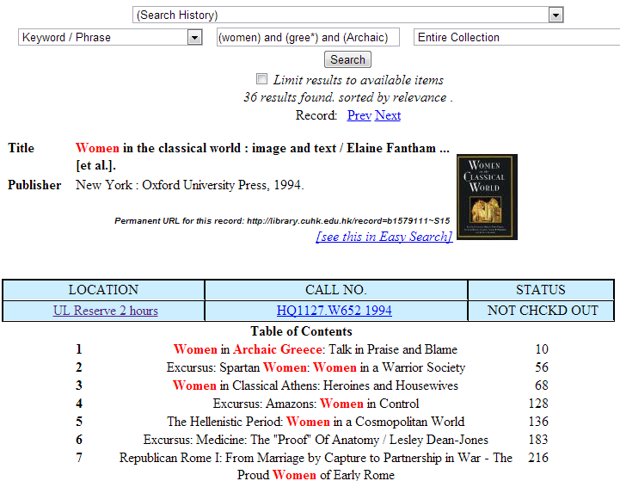
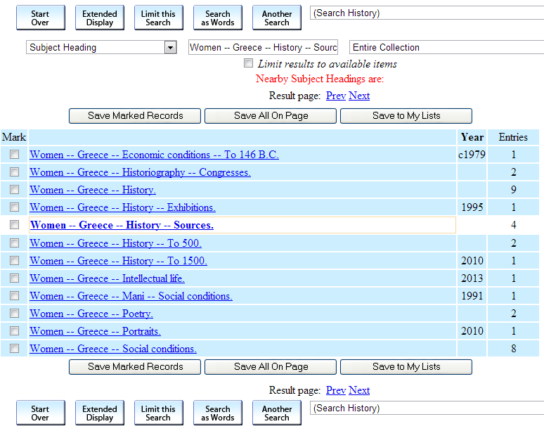
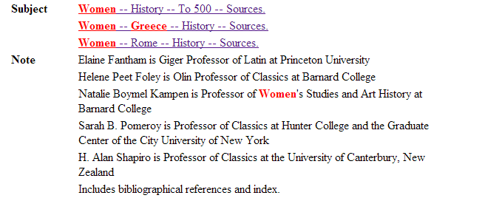
How to find more related subject headings in the library catalogue?
While browsing the result of keyword search, click on the subject heading hyperlink of the record, then transform the search into subject heading, so more related and precise subjects can be retrieved.

Slide 36
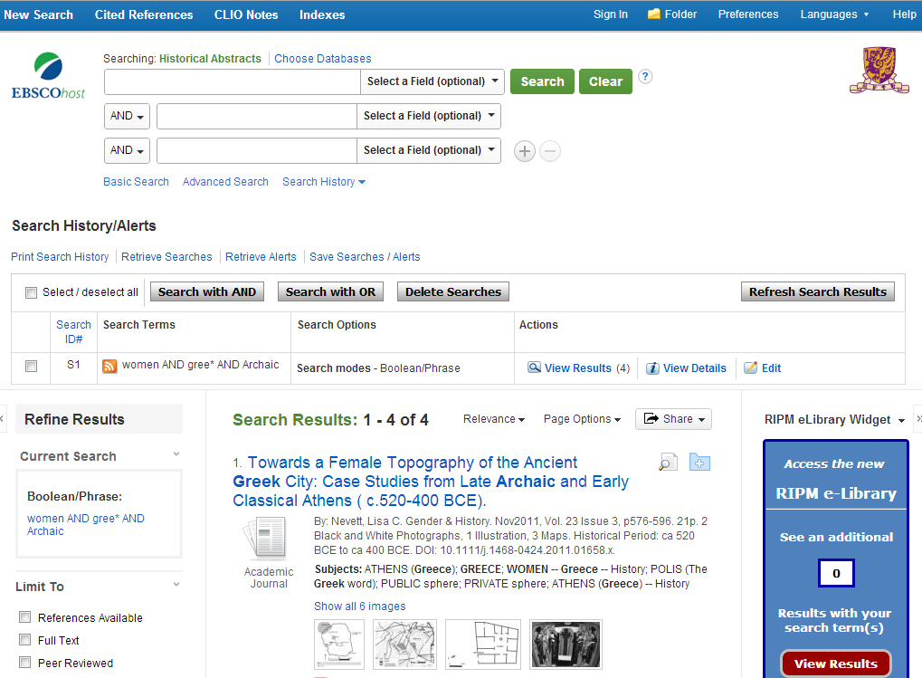
Database – Historical Abstracts
4 results found

Slide 37
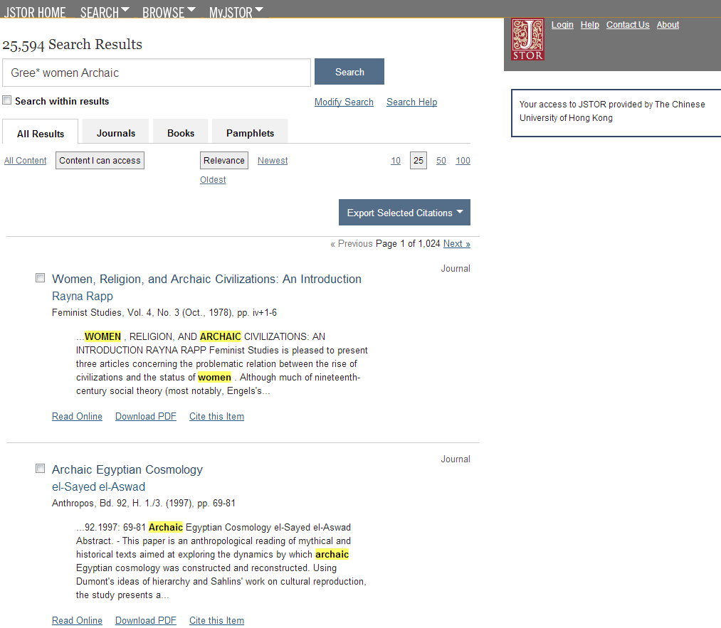
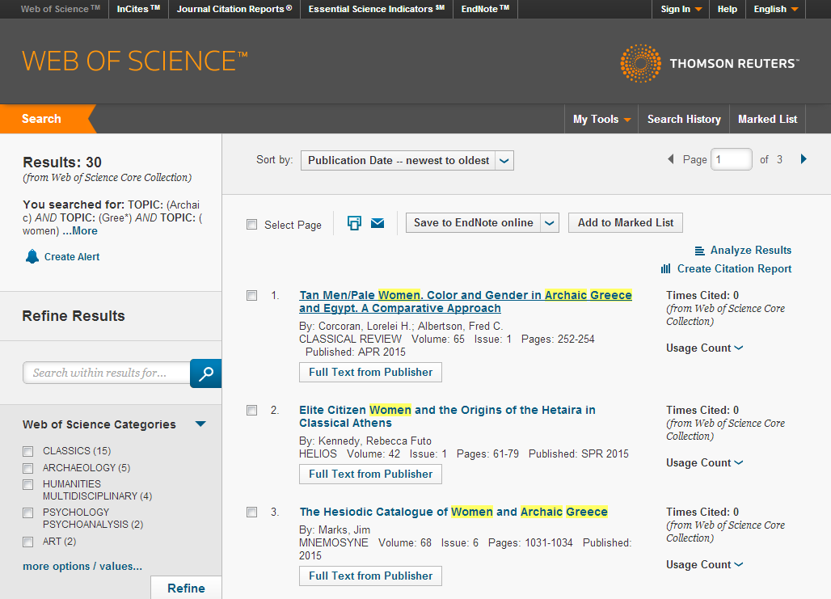
Database - JSTOR
20,007 results found
Database - Arts & Humanities Citation Index at Web of Science
30 results found

Slide 38
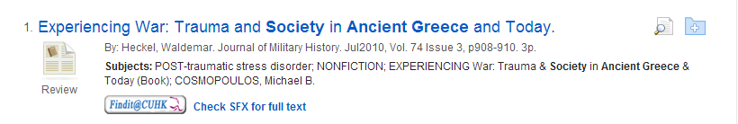
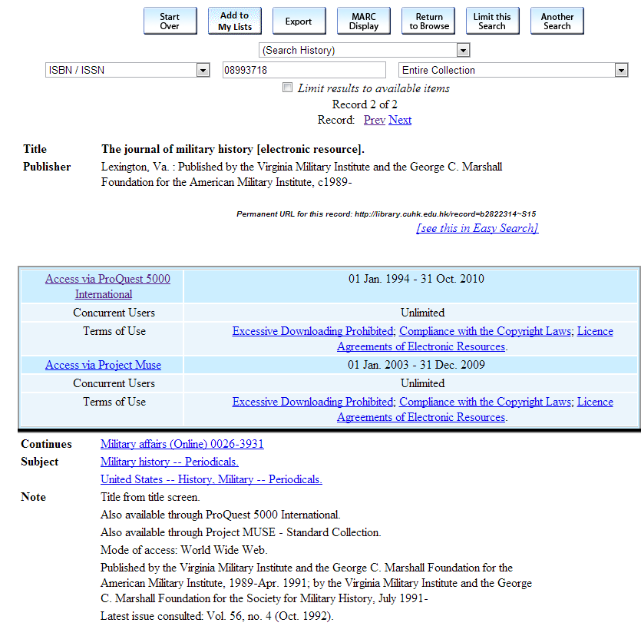
If the database doesn’t contain full-text article?
You can check if our library hold this periodical and article.
You can use the “Interlibrary Loan & Document Delivery Services” to request the article that CUHK Library does not own.

Slide 39
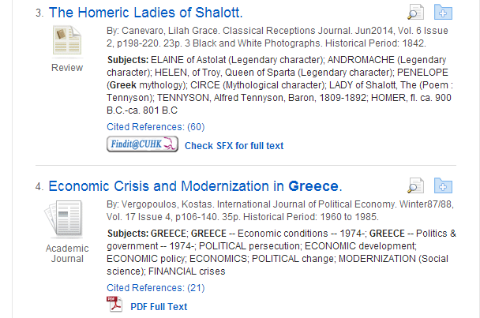
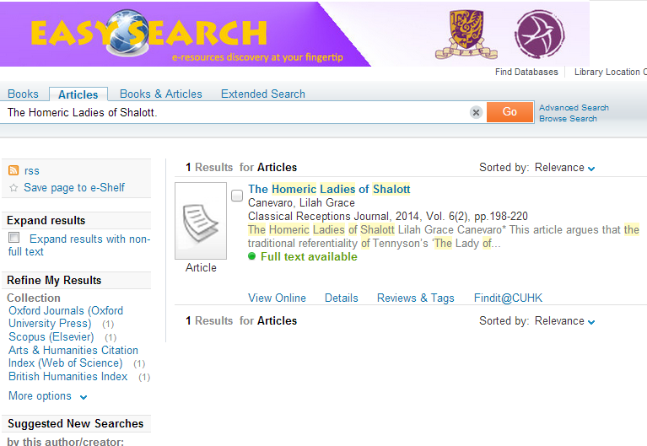
Findit@CUHK
Through the full text link resolver Findit@CUHK which is empowered by SFX, you can immediately know whether the item is available electronically and if so, be linked directly to the full text. You can also find out about availability in other formats and even pass through interlibrary loan.
On the search results list or record display page, click on the button or Findit@CUHK to check whether the item is available electronically or find out it in other formats.

Slide 40
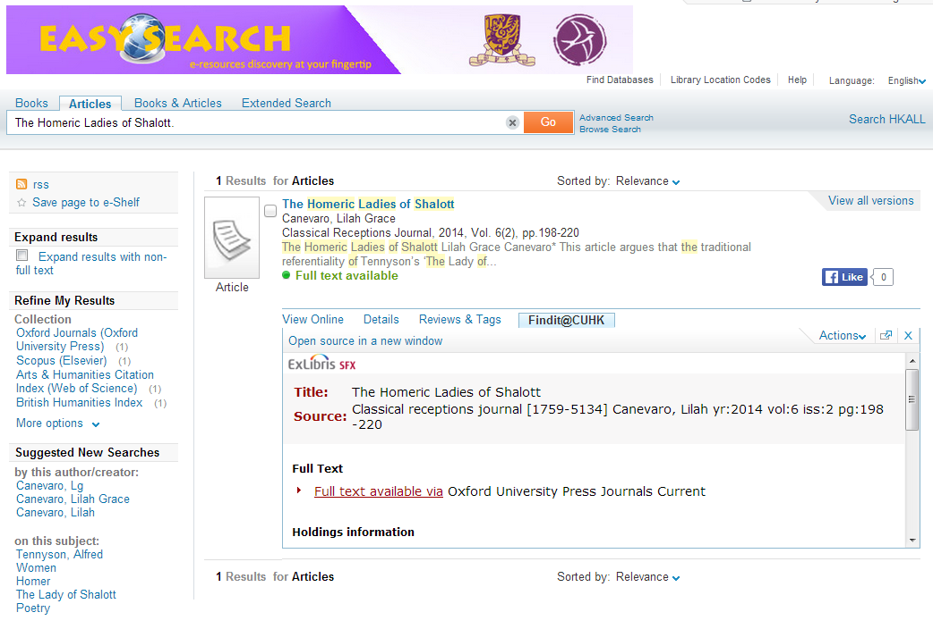
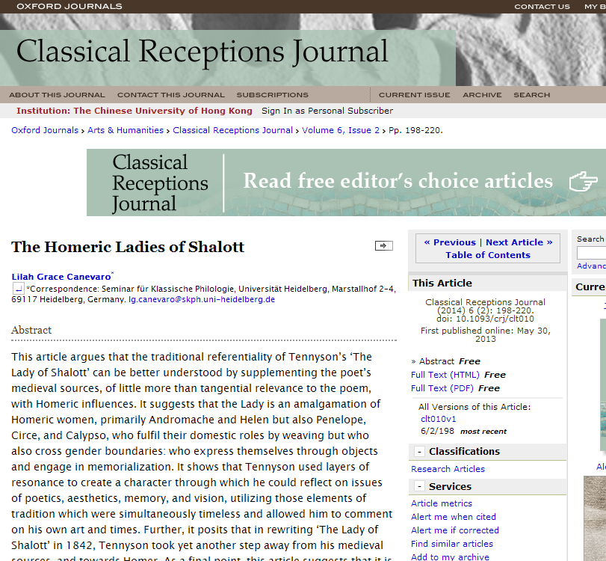

Slide 41
Analyse Your Information Needs
Medium
Fiction,
Film etc.
Culture,
Politics,
Economy
and etc?
Concepts
Key authors &
organization
Writer?
Translation
organization?
Ancient
Greece
Time period
Homeric,
Archaic,
Classical
and etc?
Amount of
Information
Few or many?
General or
specific?
Books,
Articles,
Theses?
Types of
information
Southeast,
Southwest,
center and etc?
Geographical
regions

Slide 42
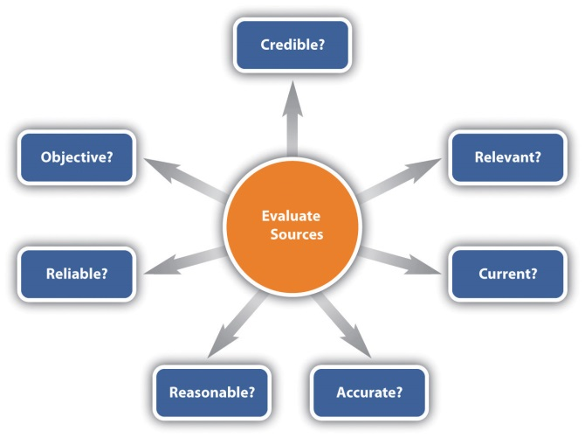
Evaluate Information Sources
Who writes?
  authority of authors/publishers
  author’s qualification or credential shown
  author/publisher/editors has the expertise on that field of study
  author associated with a reputable institution or organization
When is it written?
  currency of information
Whom is it written for?
  intended audience
Accuracy?
  if the information presented is flawless
Any biased?
  viewpoints of author
Coverage?
  if the work is comprehensive enough for your needs
Any review?
  if other reputable scholars agree or argue with the viewpoints presented in the work

Slide 43
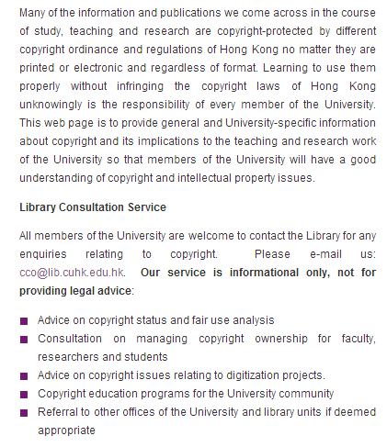




Copyright
http://www.lib.cuhk.edu.hk/en/research/copyright

Slide 44
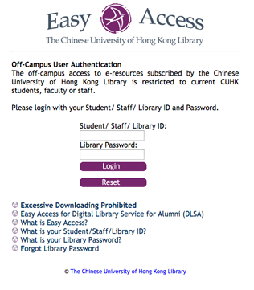

Method of Remote Access
Remote access to research databases is available via Easy Access, VPN Connection Service or Library's proxy server service.

Slide 45
Thank you
Email: leo-ma@cuhk.edu.hk
Tel: 3943-7658

